Slide 1

CUSTOM KNOWLEDGE BASE CHATBOT
B N Swaminathan
​

Slide 2
Agenda
1
2
3
4
5
Abstract
Introduction
Details about the training
Project Description
Project Design

Slide 3
Agenda
6
6.1
6.2
7
8
Sample output
High level Overview
Low level Overview
Conclusion
References

Slide 4
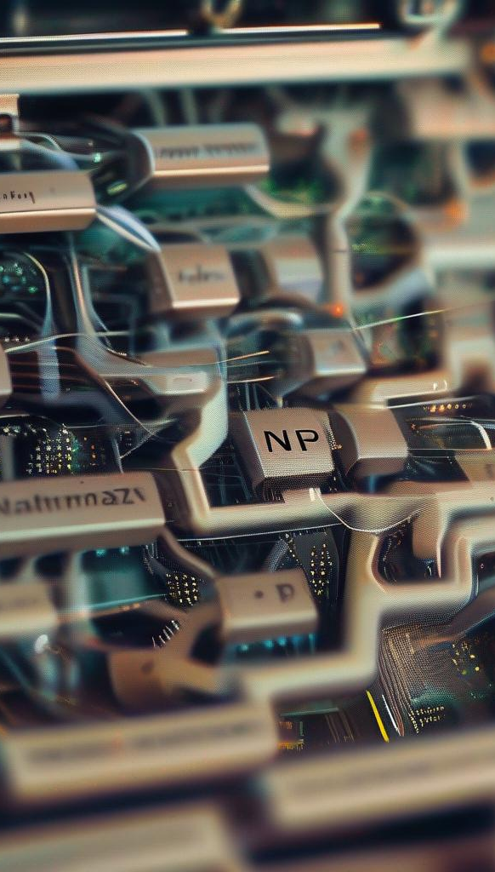
Abstract
The Custom Knowledge Base Chatbot project aims to develop an intelligent system that efficiently retrieves and provides accurate answers to user queries from a vast knowledge base. Utilizing advanced natural language processing (NLP) techniques, this chatbot combines state-of-the-art models for question answering (QA) and text generation. By integrating these technologies, the chatbot ensures precise, contextually relevant responses, enhancing user interaction and information accessibility.

Slide 5

Introduction
In the modern digital landscape, quick and accurate access to information is essential. Traditional search methods often fall short in providing immediate, relevant answers. The Custom Knowledge Base Chatbot addresses this gap by leveraging advanced NLP models to understand and respond to user queries naturally. This project integrates robust document retrieval mechanisms, a QA pipeline, and a generative text model to deliver a seamless user experience, capable of handling both straightforward and complex queries.

Slide 6

Training details
D4 Insight

Slide 7





Project
Planning
Define project objectives, scope, and success criteria.
Environmental Setup
Prepare the development environment and install necessary tools.
Design
Outline system architecture and design the chatbot components.
Testing/Enhancements
Conduct tests to ensure functionality and iteratively improve the system.
Deployment
Launch the chatbot application in a production environment.

Slide 8
Additional Learnings
DevOps Basics
CI/CD: Automating build and deploy processes.
Version Control: Managing code changes with Git.
Azure Essentials
Azure Portal: Managing resources and services.
Virtual Machines: Running applications on Azure VMs.
Azure Storage: Storing data securely in the cloud.
App Service: Deploy, manage and termination of an application.

Slide 9
Project Description
The Custom Knowledge Base Chatbot is designed to provide users with a highly interactive and responsive tool for information retrieval. Key functionalities include:
Document Retrieval and Embedding: Converts documents into embeddings to facilitate efficient searching and retrieval.
QA Pipeline: Extracts accurate answers from retrieved documents using the roberta-base-squad2 model.
Generative Text Pipeline: Generates detailed responses using the gpt-neo-2.7B model for more complex or open-ended queries.
User Interface: Built on Streamlit, providing an intuitive platform for users to interact with the chatbot.

Slide 10







Technology Stack
Programming language
Web Framework
NLP Libraries
NLP Libraries
Python
Streamlit
Sentence Transformers
Hugging Face Transformers
Document Processing
Similarity Search
Version Control
Deployment
LangChain
FAISS
Git
Streamlit

Slide 11
Project design
Document Processing:
Model Pipelines:
Streamlit Interface:
Documents are ingested from various sources and converted into embeddings using the SentenceTransformer model.
Embeddings are stored in a FAISS index to enable quick and relevant retrieval.
The QA pipeline, powered by roberta-base-squad2, focuses on providing precise answers.
The generative pipeline, using gpt-neo-2.7B, handles more conversational and detailed responses.
The front-end interface is built using Streamlit, allowing users to input queries and receive responses in real time.
The interface supports displaying retrieved documents and model-generated answers, ensuring transparency and user engagement.

Slide 12

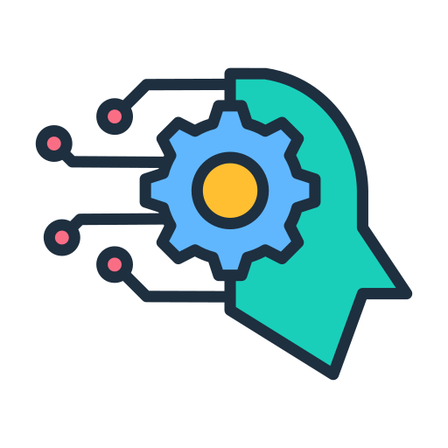

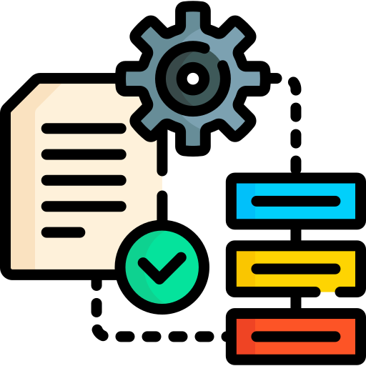
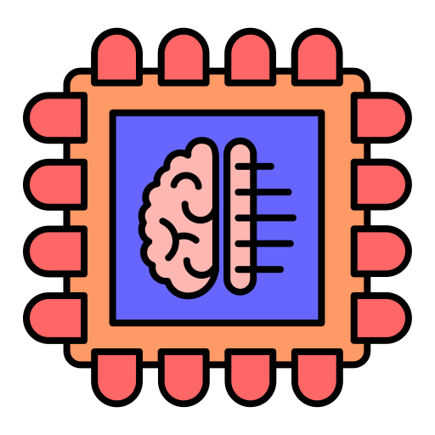

User Interface
(Streamlit Frontend)
Model Initialization (Sentence, QA, Generative)
Answer Generation
(QA Mode, Generative Mode)
Document Processing
(URL Loader, Splitter)
Embedding & Retrieval
(Compute Embeddings, FAISS Index)
Chat Logging
(Log to JSON)

Slide 13
Streamlit Interface
- Text Input (URLs)
- Radio (Mode Select)
- Text Input (Ques.)
- Display (Answer)
Document Processing
- URL Loader
- Text Splitter
Model Initialization
- Sentence Model
- QA Pipeline
- Generative Pipeline
Embedding & Retrieval
- Compute Embeddings
- FAISS Index
Utility Functions
load_sentence_model()
load_qa_pipeline()
load_generative_pipe.
compute_embeddings()
initialize_faiss_index
retrieve_rel_docs()
generate_answer()
log_chat()
Chat Logging
- Log to JSON
Answer Generation
- QA Mode
- Generative Mode

Slide 14
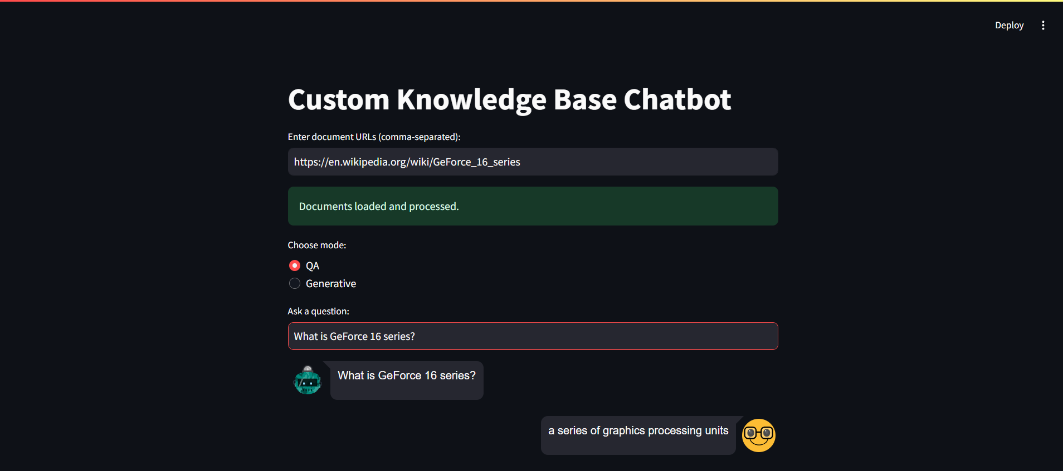
Sample Output: QA mode

Slide 15
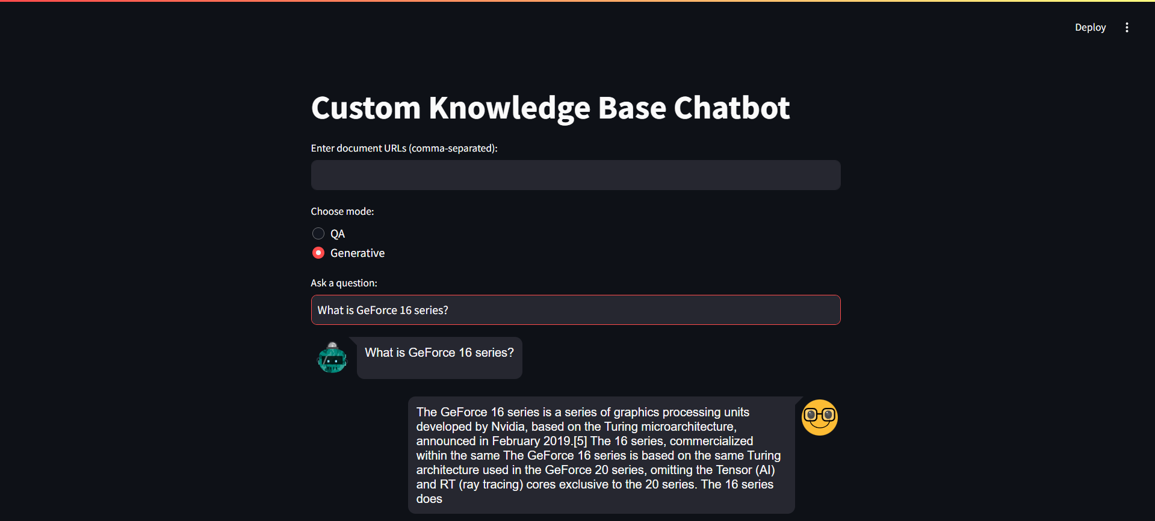
Sample Output: Generative mode

Slide 16

Conclusion
The Custom Knowledge Base Chatbot represents a significant advancement in information retrieval and user interaction. By integrating cutting-edge NLP models for both question answering and text generation, the chatbot offers a powerful tool for accessing information quickly and accurately. This project not only enhances user experience but also sets a foundation for continuous improvement and scalability in intelligent information systems.

Slide 17
Empowering knowledge through intelligent conversations.
“
”

Slide 18
References
Devlin, J., Chang, M.-W., Lee, K., & Toutanova, K. (2018). BERT: Pre-training of Deep Bidirectional Transformers for Language Understanding. arXiv preprint arXiv:1810.04805.
Reimers, N., & Gurevych, I. (2019). Sentence-BERT: Sentence Embeddings using Siamese BERT-Networks. arXiv preprint arXiv:1908.10084.
EleutherAI. (2021). GPT-Neo. Retrieved from https://github.com/EleutherAI/gpt-neo
Radford, A., Wu, J., Child, R., Luan, D., Amodei, D., & Sutskever, I. (2019). Language Models are Unsupervised Multitask Learners. OpenAI Blog.
Johnson, J., Douze, M., & Jégou, H. (2017). Billion-scale similarity search with GPUs. IEEE Transactions on Big Data, 7(3), 535-547.

Slide 19
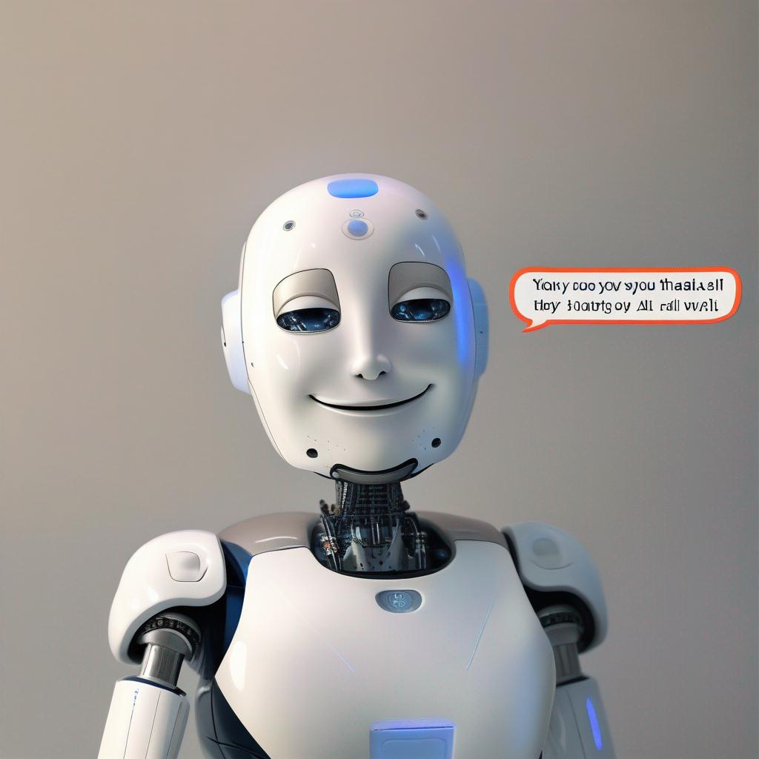
Thank you
B N Swaminathan
Swamibhuvanesan@gmail.com
8825803793
Github

